Slide 1
Weiss Center National Advisory Council
Y2 Mid-Year Meeting
Tuesday, February 27, 2024

Slide 2
What is the most common accessibility issue on the web?
Missing form labels
Missing alternative text
Low contrast text
Empty links

Slide 3
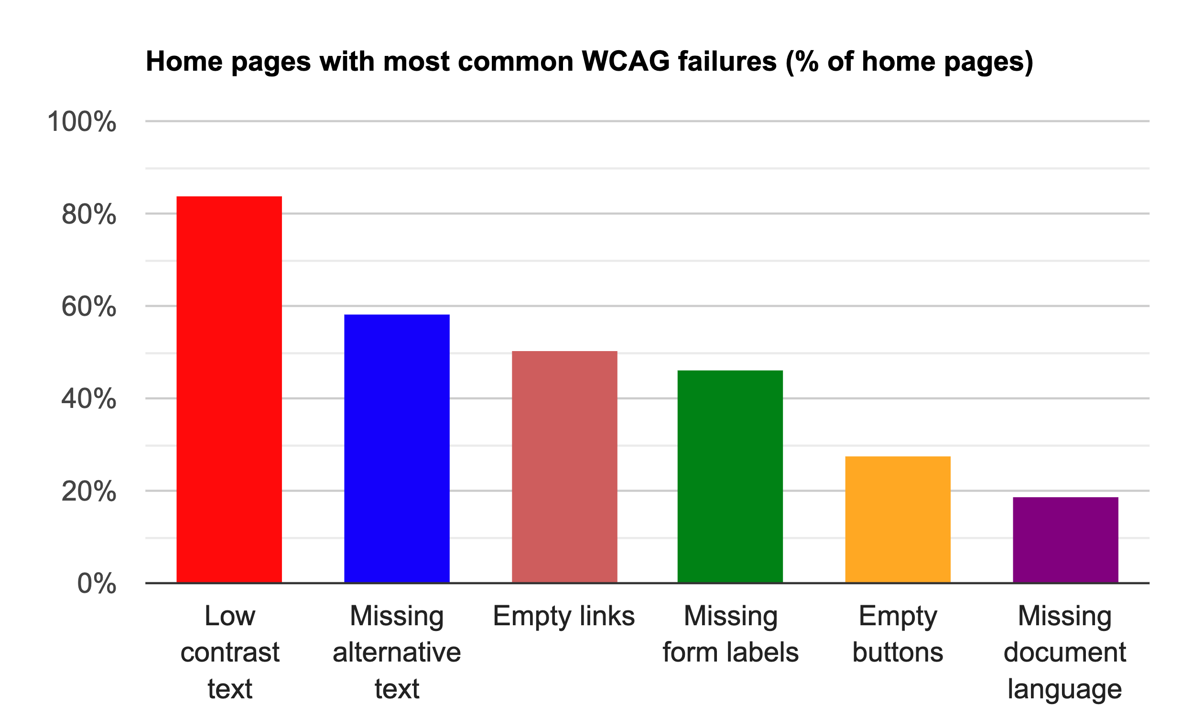
Fun Fact – 2023 report on accessibility of one million home pages
Source: Bar graph from WebAIM

Slide 4
Introduce Yourself
Name and Organization

Slide 5
Today’s Agenda
1
Center Updates
Fred Edora & Johan Rempel
2
Dissemination & Communication Update and Feedback
Darren Wright
3
Break
10 minutes
4
Technology Update
Nichole Bui
5
Your Feedback & Evaluation
Charlie Silva, Jim Lesko & Judy Lee

Slide 6
Center Updates
Fred Edora & Johan Rempel

Slide 7

Thank you!
Thank you for all the ways so far that you have helped contributed to tools, products, and evaluations efforts

Slide 8
In-Person Engagement
The Weiss Center will be at various conferences/meetings during the year, such as:
CSUN Assistive Technology Conference (March 2024)
OSEP Leadership Conference (August 2024)
ATIA 2025 Conference (January 2025)
Are there other places we can engage?
With you?
With others important to this work?

Slide 9
Products and Tools Developed
Word Document Accessibility Guide
Step-by-step guide on creating accessible documents
Part C Public Reporting Requirements
Plain Language equivalent included throughout
Several future products and tools under consideration, including:
Blogs related to IDEA data and accessibility
Guidance involving additional formats (Excel and PDF)
Articles related to disability awareness and accessibility

Slide 10
Year 1 Weiss Set-Aside
Lead: Levette Williams
Project: Creation of an accessibility data system framework and guide to help states consider accessibility in their Part B and Part C data systems
Purpose:
Attempt to incorporate accessibility in all stages of the data system lifecycle
Provide a foundation for tool and resource development

Slide 11
Weiss Center Accessible Curriculum
Weiss Center Accessible Documents and Reports Curriculum will consist of online modules designed to support individual self-study
will support and align with other training resources presented by the Weiss Center including webinars, how-to guides and check lists, and technical assistance
Three Content Delivery Phases:
Introductory (Year 2)
Intermediate (Year 3)
Advanced topics (Years 4 and 5)

Slide 12
Dissemination & Communication
Darren Wright

Slide 13
Website Improvements
WeissTA.org

Slide 14
Background
In the Fall of 2023, the Weiss Center’s external evaluator conducted a Quality Assurance Review, or QAR, of the website (www.WeissTA.org).
Respondents were NAC members, representing:
State Departments of Education
National technical assistance centers
State or nationally-focused data and accessibility projects
Higher education.
This QAR asked respondents to rate the website on its quality, relevance, and usefulness.

Slide 15
Feedback: Website Quality
Maintain “clean” design.
Revisit color contrast in certain areas.
Incorporate plain language and streamlined messaging.

Slide 16
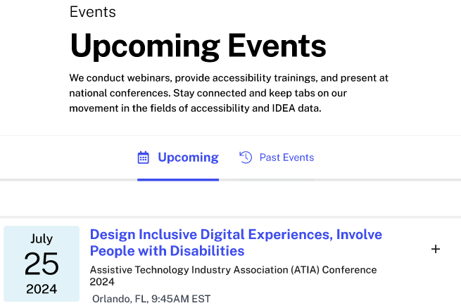
Improvements: Website Quality
We will maintain a simplistic design, with added components and formatting that are more conducive to “skimmability.”
Rather than walls of text, we will leverage:
Bulleted lists
Tabulated information
Streamlined views
Plain language summaries

Slide 17
Feedback: Website Relevance
More diverse representation.
Build awareness of the importance of data accessibility.
Increased transparency for users to request assistance.

Slide 18
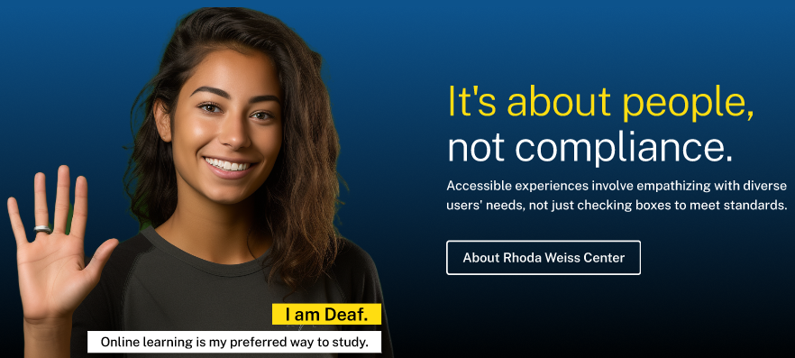
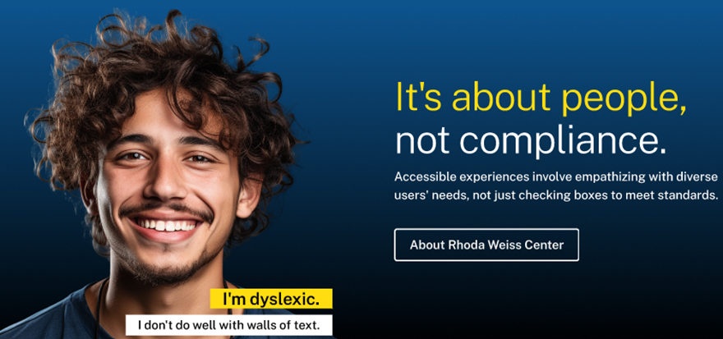
Improvements: Website Relevance (1 of 2)
Additions have been applied to increase the diversity of those represented across the website.
On the home page, a carousel of various individuals and disabilities will be displayed, each with their own alternative text.

Slide 19
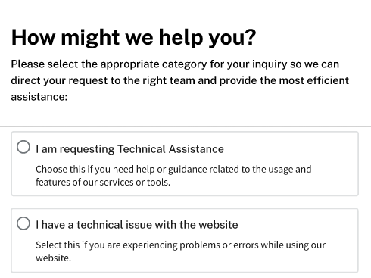
Improvements: Website Relevance (2 of 2)
A streamlined avenue for users to connect with the Weiss Center through an accessible, embedded form.
This form will allow users to best tailor their request to ensure their inquires are addressed promptly and effectively.

Slide 20
Feedback: Website Usefulness
Incorporate search functionality.
Build out a more robust resource library.
Empower users with more “How-to” resources.
Demonstrate the impact of making data accessible.

Slide 21

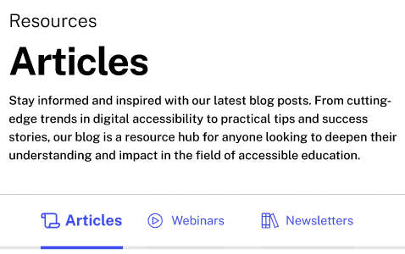
Improvements: Website Usefulness
Incorporate search functionality, eventually including:
Keyword search
Search suggestions
Related resources
Continue to broaden the library of available resources and expand the types of resources.

Slide 22
Universal TA
Webinars

Slide 23
Weiss Webinar: Blueprint
One webinar per quarter, totaling four webinars per year.
Previous Webinars:
Rhonda Weiss Center Kickoff
Introduction to Disability: A Cultural Shift
Accessible IDEA Data: The What and Why
Document Accessibility: A Basic Overview Incorporating Universals Design
Upcoming Webinars:
How to Make SPP/APR Reports Accessible
The Ins and Outs of ADAPT
State Stories and Accessible Outcomes

Slide 24
Weiss Webinar: Topics
What topics, issues, or questions related to IDEA data and/or accessibility would you like the Weiss Center to address in the future?
Drop it in the chat and let’s discuss!

Slide 25
Communication Strategies
Diverse Stakeholders

Slide 26
Communication Strategy Questions
In your current or a previous role, what communication strategies have you deployed to get your message across?
How do you go about tailoring your messaging depending on the audience?
To you, what are key considerations when developing a communication plan or approach?

Slide 27
Break
10 minutes

Slide 28
Technology Update
Nichole Bui

Slide 29
ADAPT Overview
Accessible Data Analysis and Publishing Tool

Slide 30
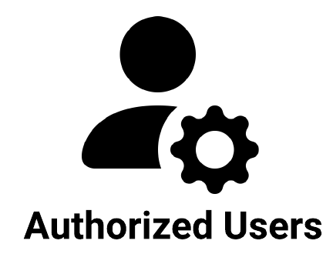

ADAPT Users
Authorized State users have access to ADAPT Admin.
IT, data managers, state directors, administrators, etc.
Public users have access to ADAPT Viewer.
Students, parents, educators, researchers, advocates, etc.

Slide 31
Step-by-Step Guide to ADAPT
STEP 1
States implement ADAPT in their cloud environment and upload data from their:
State Data Warehouse
CEDS Data Warehouse
IDEA Part B/C Files
STEP 2
In ADAPT Admin, state authorized users can create accessible data reports.
STEP 3 State authorized administrators review the created reports to:
Approve
Request revisions
STEP 4 Once approved, the accessible data reports can be published to ADAPT Viewer and accessed by the public.
ADAPT - Accessible Data Analysis and Publishing Tool CEDS - Common Education Data Standards IDEA - Individuals with Disabilities Education Act

Slide 32
ADAPT Demo

Slide 33
Feedback
What accessibility features for ADAPT stood out to you?
What would make ADAPT even better?
What opportunities exist for the Weiss Center to collaborate with other organizations?

Slide 34
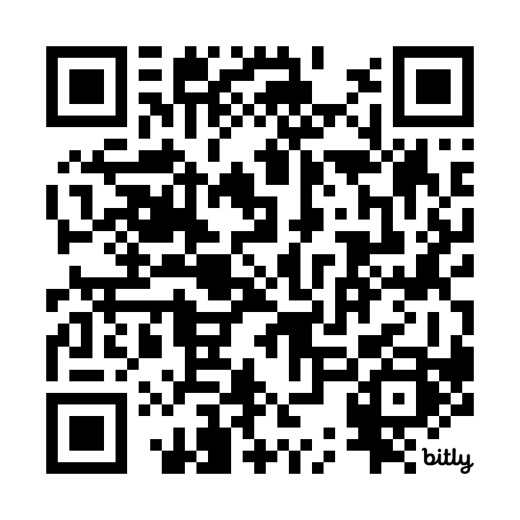
1:1 NAC Feedback
Use QR code provided to schedule:
30 minutes to give feedback on ADAPT demo.
60 minutes to participate in usability study.

Slide 35
ADAPT Roadmap

Slide 36
Features for State Users (1 of 2)
Manage Data Sources
Manage Data Views
Manage Reports
Manage Glossary
Define the location where data that is being used for reporting originates from.
Define the collection of data that is used for reporting.
Develop reports that display the data representation in an accessible format.
Define the definitions for commonly used terms that are referenced in reports.

Slide 37
Features for State Users (2 of 2)
Manage Users
Manage Branding
Manage Disclosure Avoidance
Manage Tool Settings
Assign users and their roles and permissions.
Configure the logo and colors to match the State’s branding guides.
Define suppression rules to protect student privacy based on reporting level for the State.
Configure the ADAPT experience based on the State’s specific requirements for workflow approvals, publishing, data taxonomy, etc.

Slide 38
Features for Public Users
View Reports
View Glossary
Access and filter reports published by the State. View and download tabular data.
View definition for terms used in the reports.

Slide 39
Question: What features would improve the first release?

Slide 40
Evaluation
Judy Lee

Slide 41
Meeting Evaluation
We will share a survey link during the meeting to evaluate this meeting format and content.

Slide 42
Meeting Feedback
Jim Lesko & Charlie Silva

Slide 43
Next NAC Meeting
Lookout for an invitation from us for a virtual meeting in August

Slide 44
Thank you!
The contents of this presentation were developed under a grant from the US Department of Education, H373Q220002. However, those contents do not necessarily represent the policy of the US Department of Education, and you should not assume endorsement by the Federal Government. Project Officer: Eric Caruso.

